Slide 1
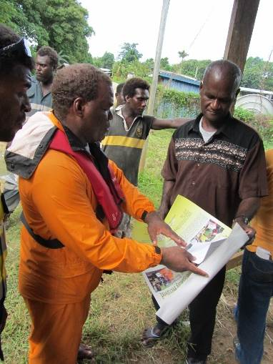
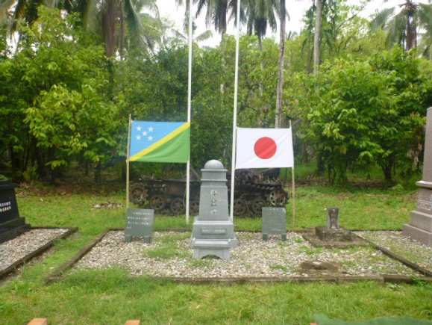
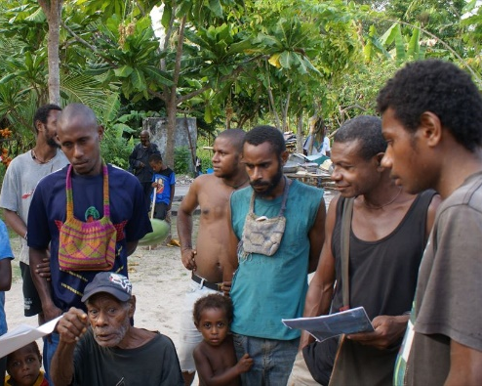
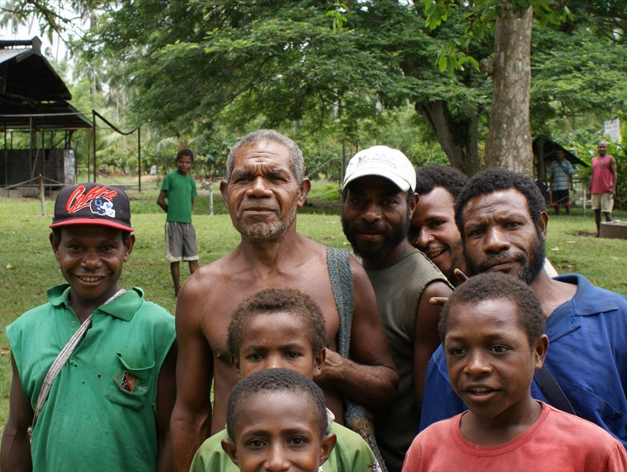
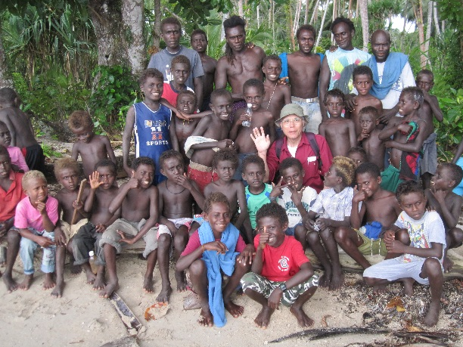
The Japanese government is searching for
the remains of former Japanese servicemen
Any information on remains highly appreciated
Today, the surviving relatives of Japanese servicemen who died overseas in the war are as hopeful as ever that the remains of
their loved ones will one day be returned to their homeland.
Approximately 118,700 Japanese servicemen lost their lives in the Bismarck Archipelago and the Solomon Islands.
The remains of around 58,710 of these have yet to be repatriated to Japan.
It is the wish of the Japanese government that as many of these remains as possible should be returned to Japan.
If you have any information on the discovery of the remains of former Japanese servicemen
(for example, when rebuilding your house or reclaiming land),
or if you have eyewitness information on caves or other sites, we request that you contact the Japanese Embassy.
[address]
Japan Association for Recovery and
Repatriation of War Casualties
Tel: (81-3)3581-2755
Fax: (81-3)6206-1880
Email:qqaf2yr9k@athena.ocn.ne.jp
Solomon Islands Embassy of Japan
4th Floor, Point Cruz Arcade Building,
Hibiscus Avenue, Point Cruz,
Honiara, Solomon Islands.
Tel : (677) 22953/23641/21073
Fax: (677) 21006

