Slide 1
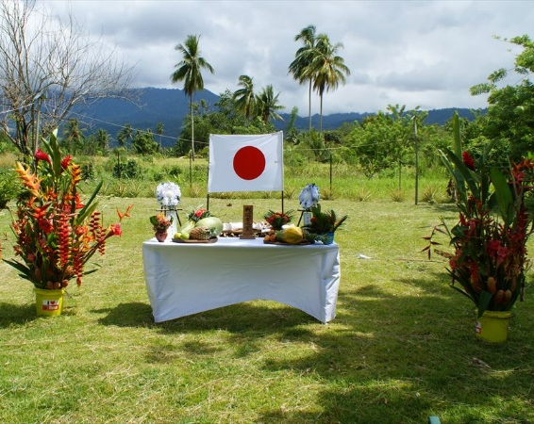
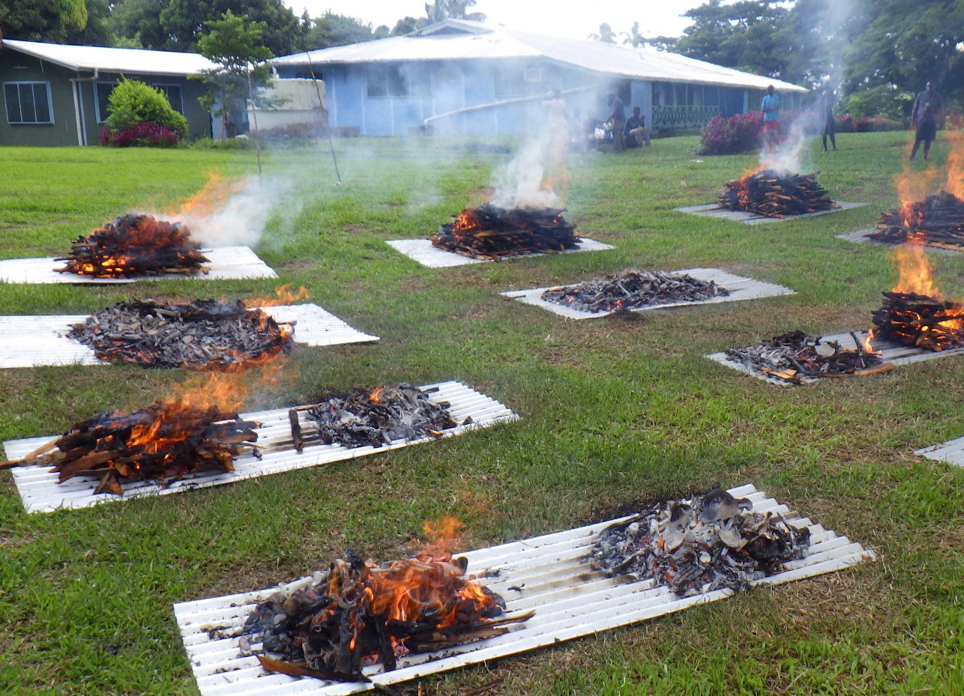
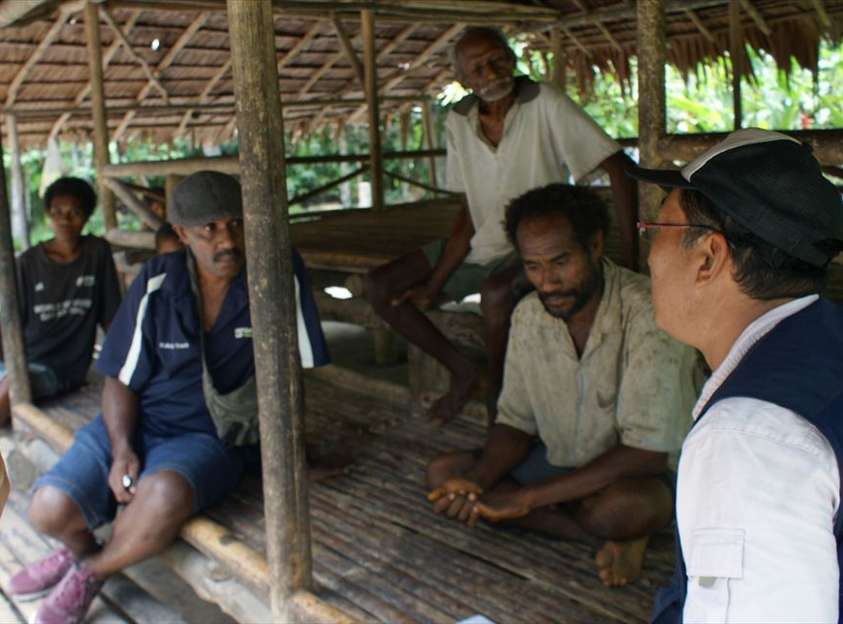
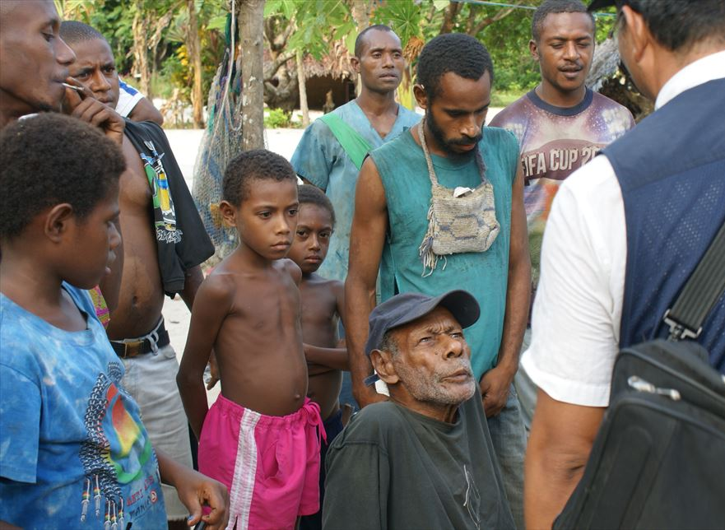
The Japanese government is searching for
the remains of former Japanese servicemen
Any information on remains highly appreciated
Today, the surviving relatives of Japanese servicemen who died overseas in the war are as hopeful as ever that the remains of
their loved ones will one day be returned to their homeland.
Approximately 127,600 Japanese servicemen lost their lives in Papua New Guinea.
The remains of around 76,320 of these have yet to be repatriated to Japan.
It is the wish of the Japanese government that as many of these remains as possible should be returned to Japan.
If you have any information on the discovery of the remains of former Japanese servicemen
(for example, when rebuilding your house or reclaiming land),
or if you have eyewitness information on caves or other sites, we request that you contact the Japanese Embassy.
[address]
Papua New Guinea Embassy Of Japan
1st & 2nd Floor, Cuthbertson House,
Cuthbertson St. Port Moresby, NCD,
Papua New Guinea
(P.O.BOX No.1040, Port Moresby 121)
Tel: (675)321-1800, 321-1483, 321-1305
Fax: (675)321-4868
Japan Association for Recovery and
Repatriation of War Casualties
Tel: (81-3)3581-2755
Fax: (81-3)6206-1880
Email:qqaf2yr9k@athena.ocn.ne.jp

